Slide 1
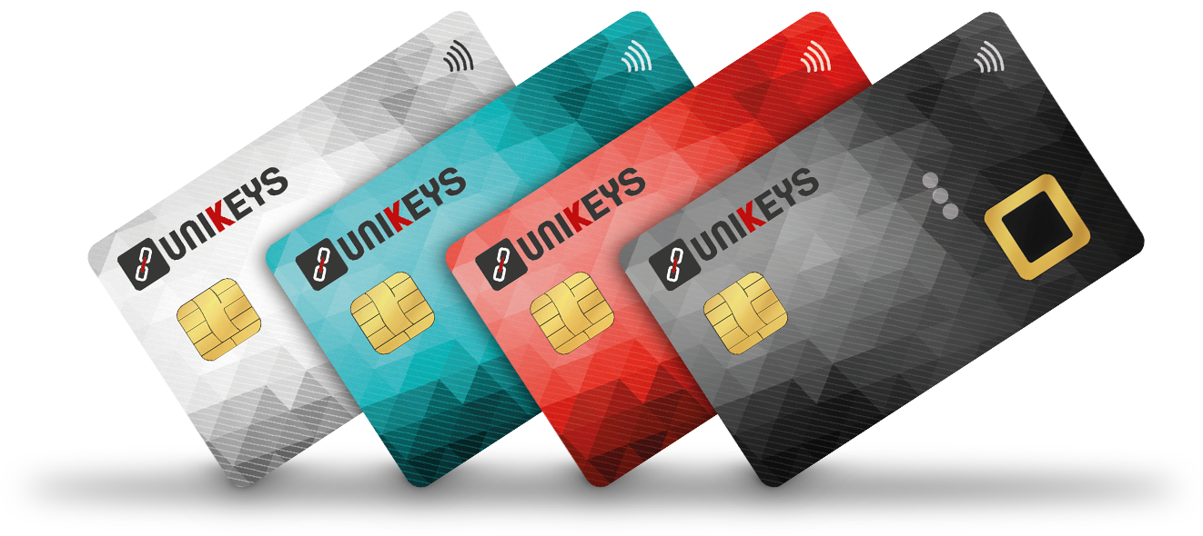

We empower people to seamlessly and safely adopt digital assets into their lives.

Slide 2
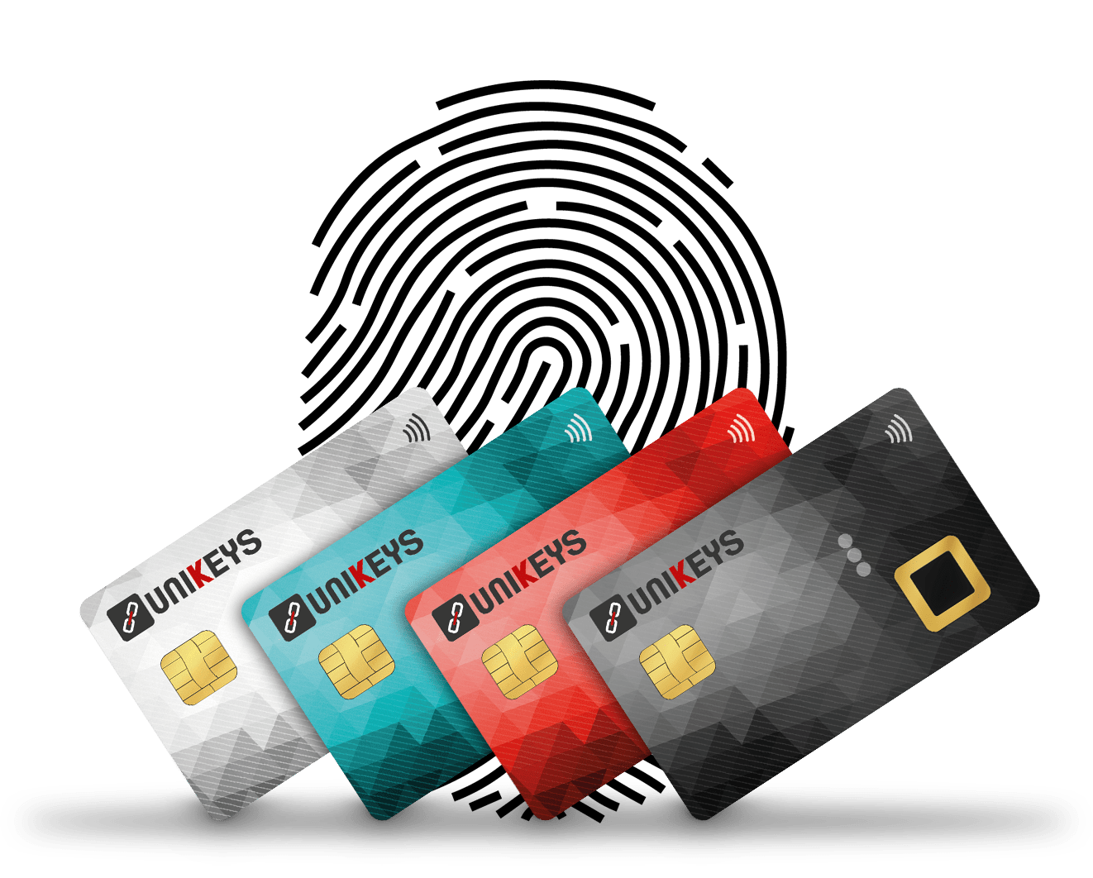
Unikeys All In One Ecosystem
Biometric Card Hardware Wallet
Enabling 3FA Security
Frictionless Transaction Experience
Enterprises Friendly (White Label)

Slide 3
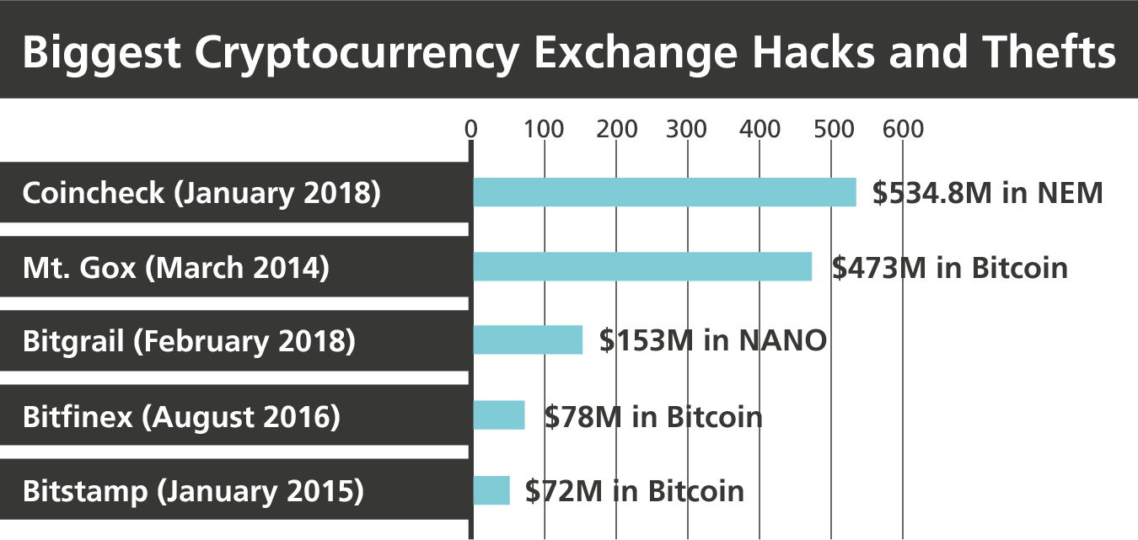
The Risks of Relying on Centralised Exchanges
Since the Mt. Gox hack, cryptocurrency enthusiasts have become more cautious with the storage of their private keys.
Private key storages are too centralised, increasing vulnerability.
Investors do not yet fully understand the risks they may be facing by leaving their crypto-assets on centralized exchanges.
Significant Governance issues for centralised exchanges with a lack of transparency.
Source: 99Bitcoins.com, Benzinga.com

Slide 4
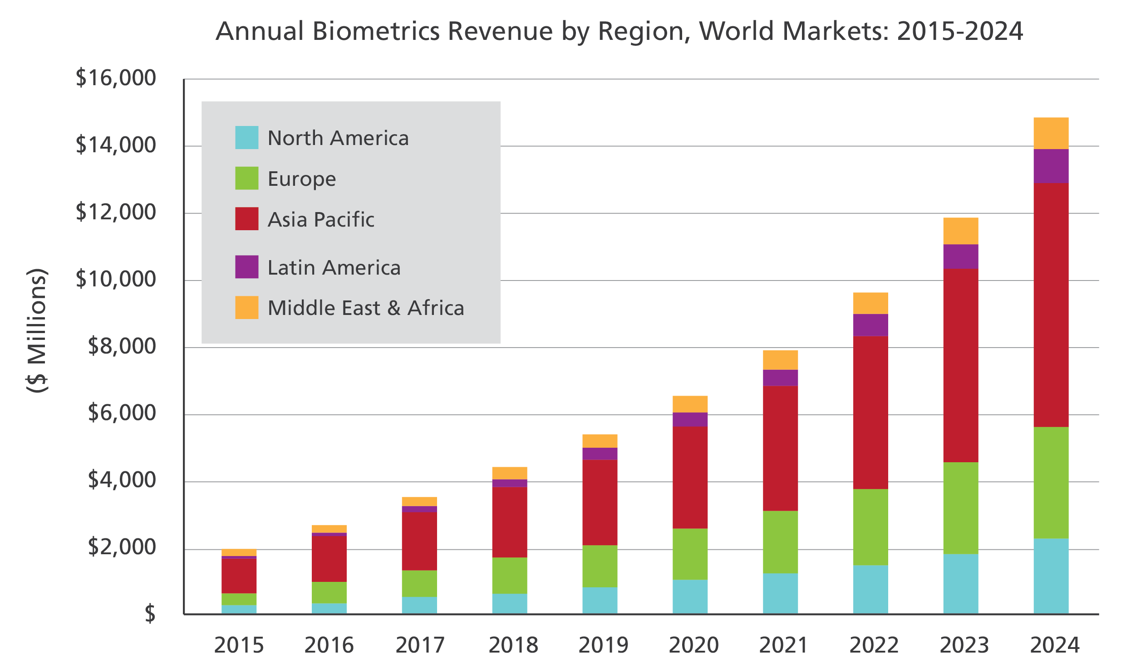
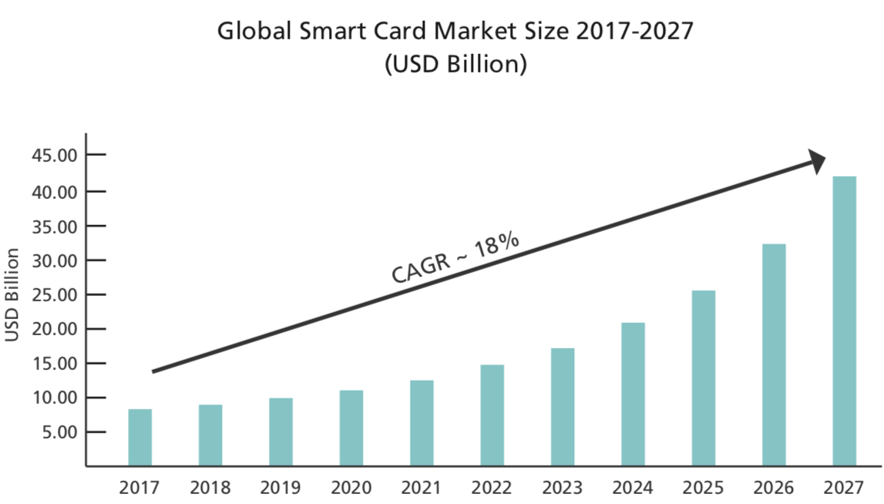
Biometrics & Smart Cards Market Perspectives
Biometrics and the Need for Better Security
Passwords account for 81% of data breaches, making them the biggest flaw in personal and enterprise security. Biometrics allow companies to replace passwords and tokens with a user friendly solution.
Multifactor authentication highly improves security. It is unlikely that an attacker could fake or steal all three elements involved in the 3 Factor Authentication process. 3FA: Something I have, Something I know, Something I am.
Smart Cards in our Lives
Financial institutions have already started to test the development and distribution of smart cards into the mass market.
The contactless card protocol in use today is insecure. The refunding cost for credit and debit cards thefts also represents a major burden for financial institutions.
A more secure card framework relying on biometrics and other features is expected to grow in the coming years.
Source: Tractica
Source: Market Research Future

Slide 5
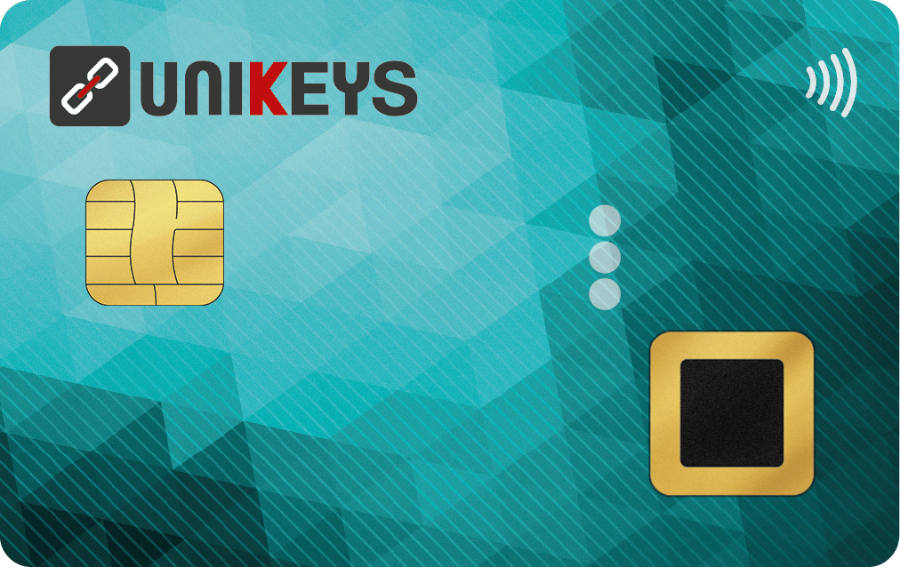
The UKey Card: A Unique Combination
Biometric Sensor
A fingerprint sensor that enhances and secures the user experience. 2 fingers can be registered. The biometric data never leaves the card.
Transport It Anywhere
The dimensions are the same as your banking card (ISO/IEC 7810).
The UKey card is compatible with the ISO dimensions.
Energy Efficient
The combination of high standard technology is guaranteed by a long lasting battery that doesn’t need to be recharged.
Robust Cryptography
Fingerprint templates and private data are stored in a certified secure element (EAL6+). Unikeys uses the most advanced cryptography standards.
NFC/EMV
EMV and NFC are embedded into the card to comply with all point-of-sale readers. The communication is only enabled when your fingerprint is recognized.

Slide 6

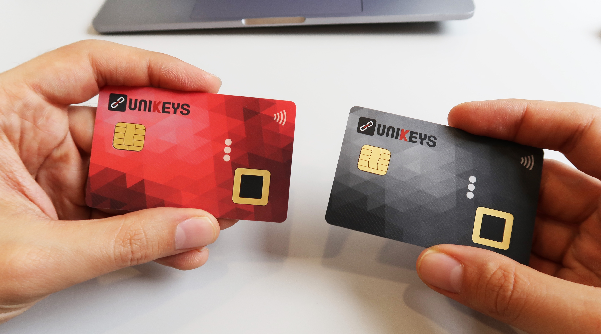
Rethinking Hardware Wallets
The fingerprint becomes the pin code.
The current contactless card protocol is highly vulnerable to hackers.
The biometric authentication secures and highly improves the UX.
The UKey card can host multiple crypto-assets
From 2FA to 3FA (Something I have, Something I know, Something I am).
The most portable and compact cutting edge hardware wallet.

Slide 7

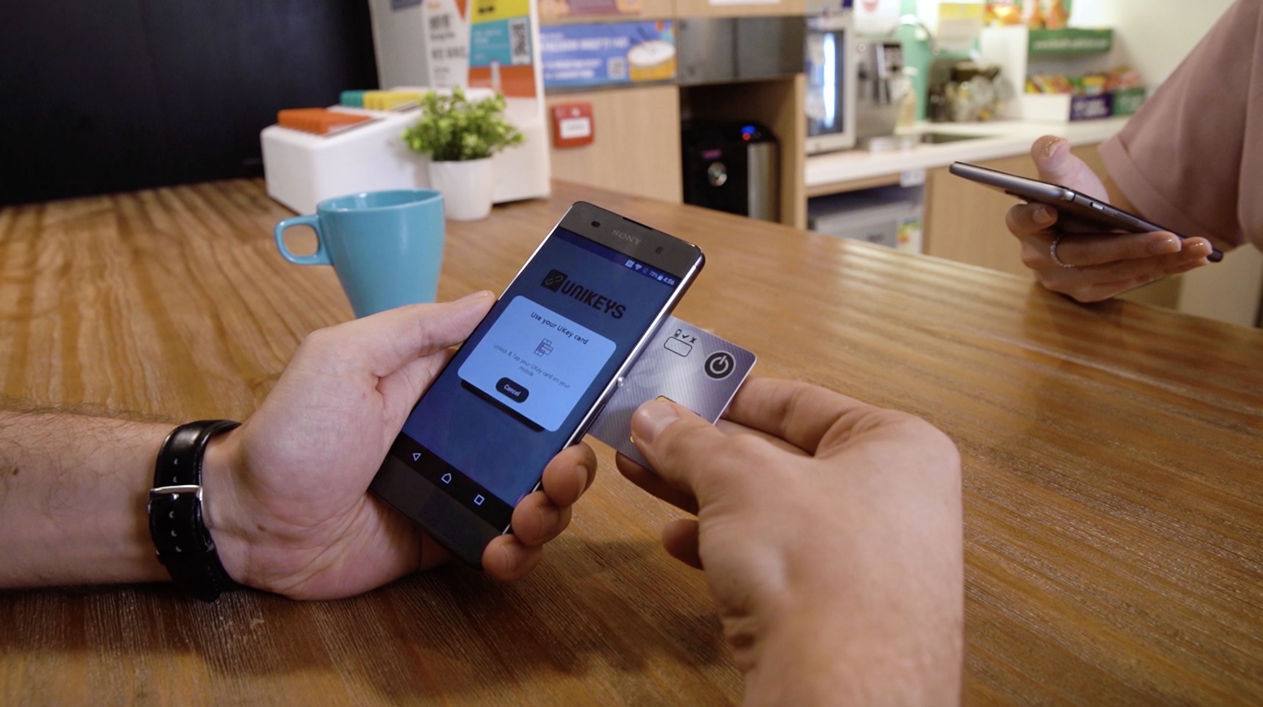
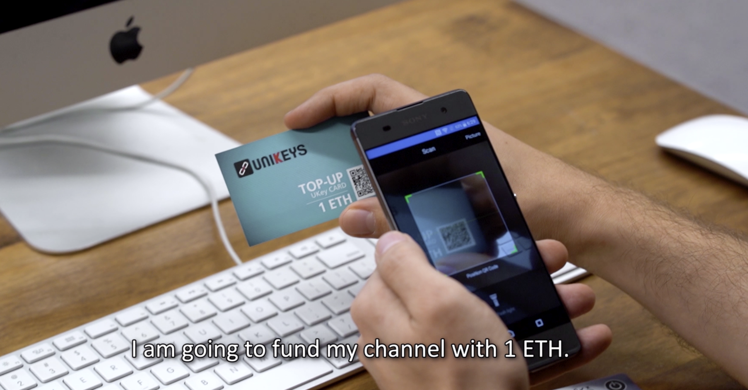
Unikeys Pilots, Introduced at Ethereum Japan
Ethereum Wallet
Goal
Utilize the UKey card to secure a private key and sign transactions on the Ethereum blockchain.
Remarks
The UKey card enables the access to the app and to sign transactions.
The User Experience has been praised by the community especially in comparison to the existing hardware wallets. The wallet was first introduced at the Fintech Week in London and at NYU in New York.
Payment Channels Wallet
Goal
Showcase a seamless payment channels experience from a to z by enabling a smooth creation and utilization of payment channels.
Remarks
The first worldwide implementation that showcases a payment made from a card and from a hardware wallet on top of Payment Channels. On this wallet, cryptocurrency payments are fully taking place instantly.
A complete experience from the opening of the channels, the purchase at the merchant, to the withdrawal from the merchant.

Slide 8
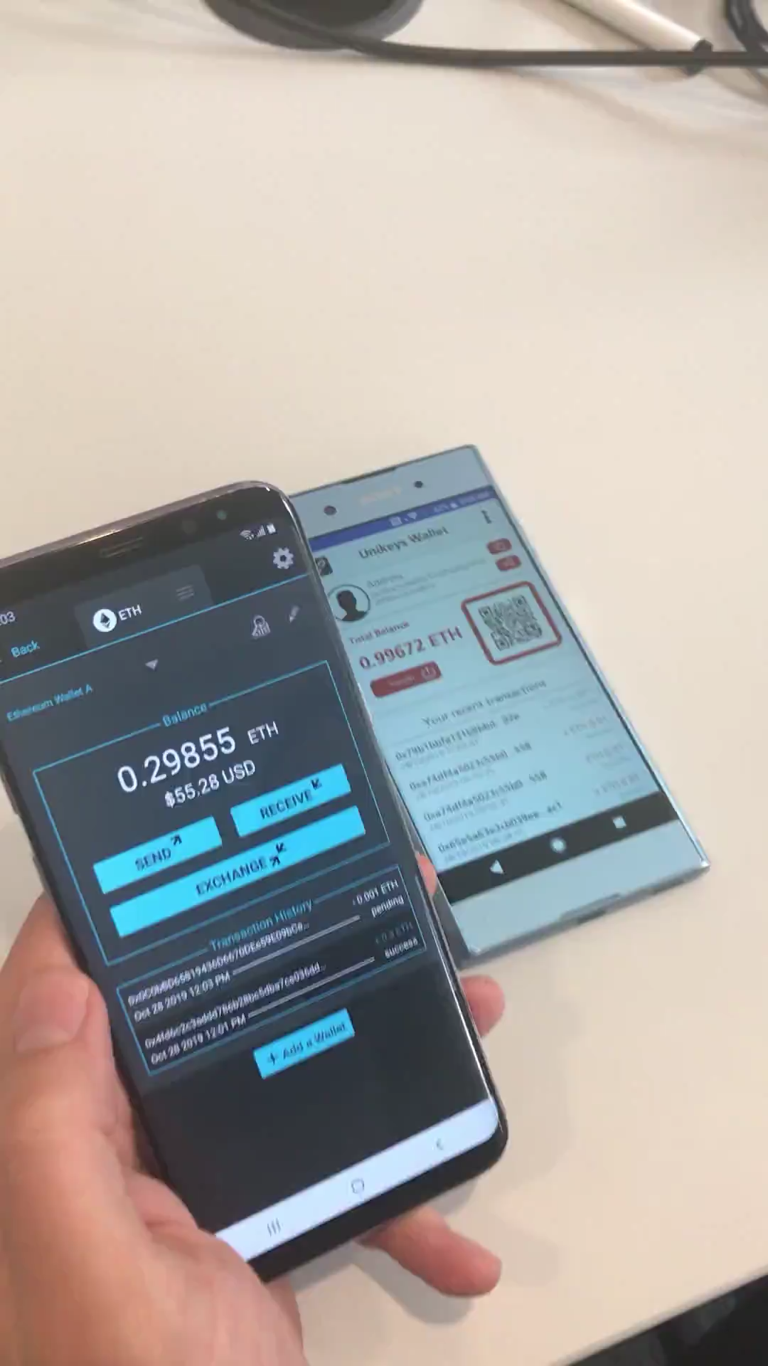
The Unikeys Mobile Wallet (Click on the Demo Video)
Physical (QR) and Online Payments
Live Price and Statistics
Optional 3FA
Possibility to Add ERC20 Tokens
Multi-Signature Framework on Demand
Scalable Infrastructure

Slide 9
The Consensys Grant, a real support!
1) Completion of the backend infrastructure
Thanks to Consensys, Unikeys managed to hire one backend developer who participated to develop an infrastructure enabling to interact with the different cryptocurrencies selected initially.
2) Proof of concept solutions
Apart from the two proof of concept we developed with ETH and on payment channels, Unikeys has rather decided to make progresses on the multi crypto application.
3) Unikeys and partnerships
Several significant partnerships are under discussion but have been delayed due to the coronavirus.
1) Set relationships with NGOs
One major NGO is currently discussing with Unikeys regarding a POC related to the identity use case.
2) Support of regulators and governmental institutions
The support obtained from Cyberport Hong Kong and Finance Innovation Paris remain essential.
3) Create a stronger relationship with Consensys
Unikeys insisted to create relationships with Consensys Hong Kong, Paris and Singapore. A couple of discussions and introduction took place thanks to the Consensys grant opportunity.

Slide 10
Labels and Recognitions
HONG KONG
Unikeys has been successfully selected into the 2018 Cyberport Incubation Programme, the most important startup incubator in Hong Kong.
FRANCE
Unikeys is a member of the Pôle Finance Innovation, and has received the 2018 Label delivered to the most innovative and advanced French Fintech companies.
USA
Unikeys has been selected by Consensys among its latest 2019 grantees. Consensys will provide an R&D grant as well as introduce Unikeys to its different solution maker.

Slide 11


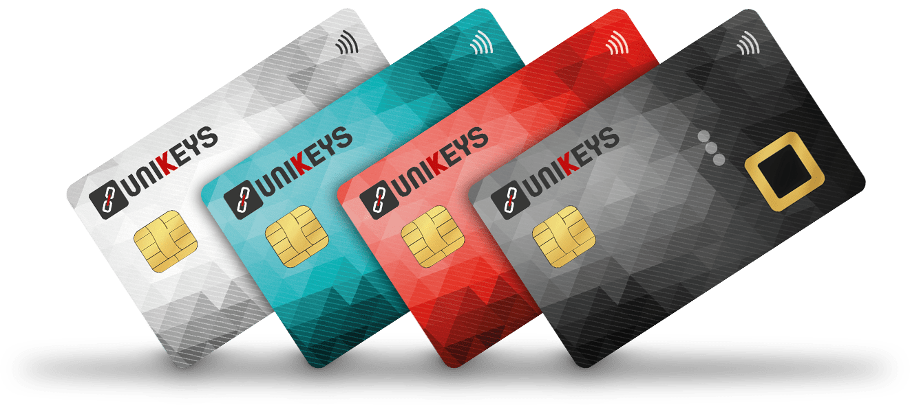
THANK YOU!

